Slide 1


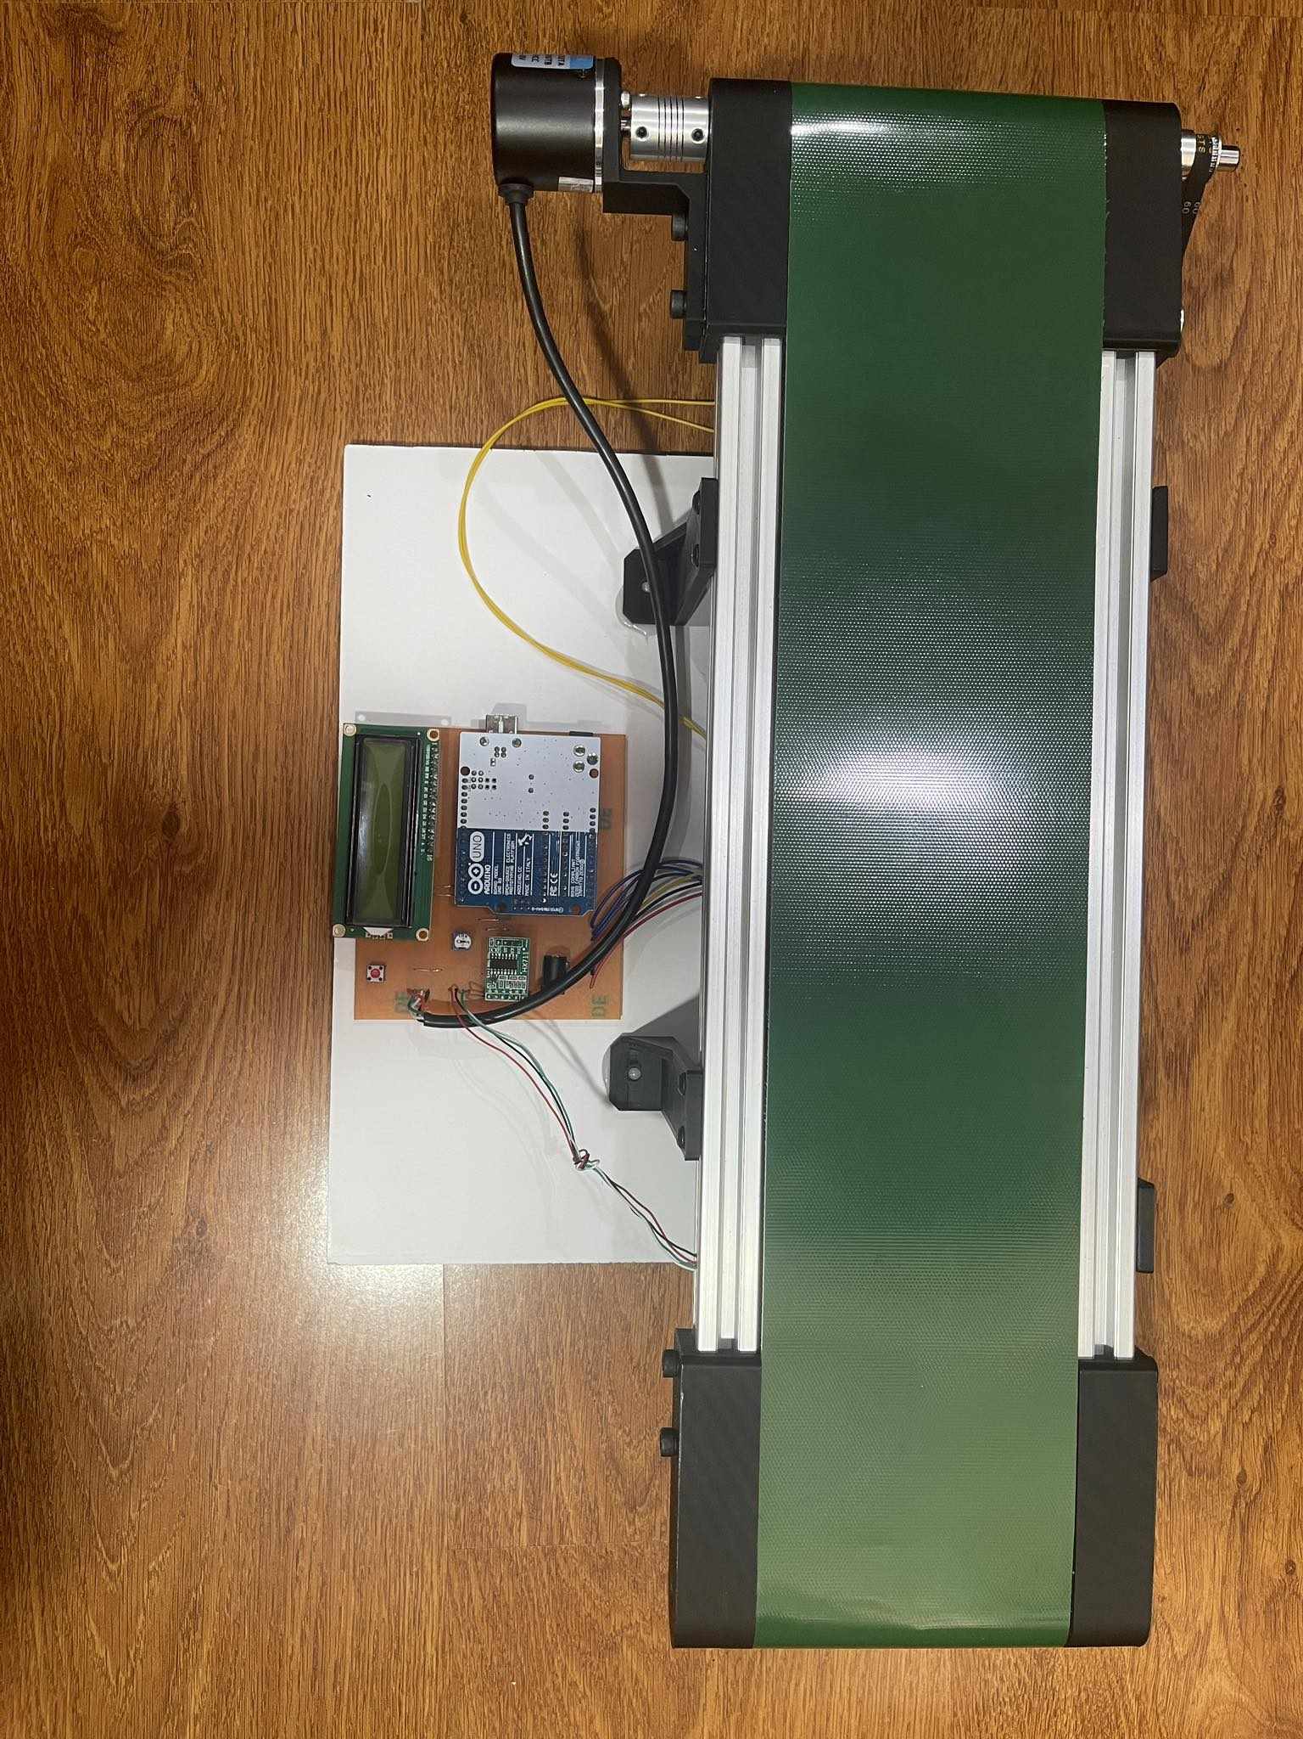
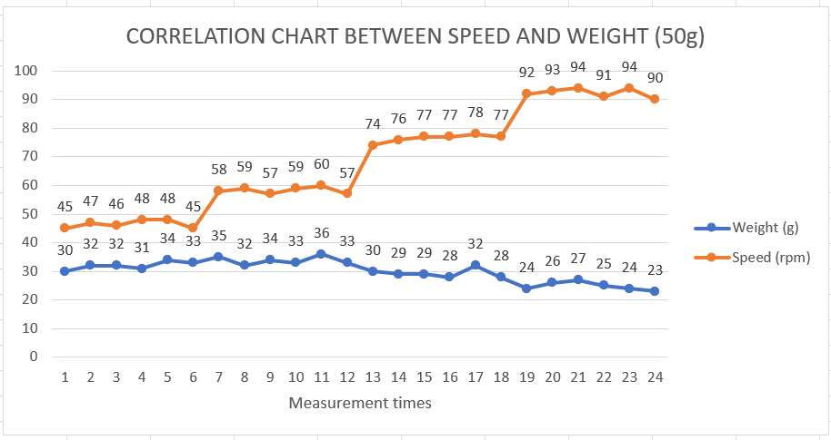
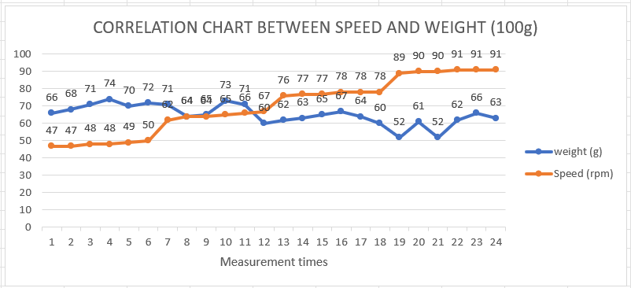
DESIGN OF DYNAMIC WEIGHING SYSTEM
Executor: Dinh Nguyen Gia Phu – Advised Mr. Thieu Quang Tri
AUTOMATICAL AND CONTROL ENGINEERING, FACULTY OF ELECTRICAL ENGINEERING, TON DUC THANG UNIVERSITY
TARGET
INTRODUCE
The dynamic weighing system described in this study is intended for easy integration into an extensive amount of industrial conveyor applications. The ability to accurately measure product weight on the move can benefit many manufacturing and distribution processes that currently rely on intermittent static weighing.
Using encoder pulses to calculate conveyor velocity.
Implementing variable speed motor control through an L298N driver.
Displaying weight and speed values on an LCD module.
Meeting target accuracy and precision metrics based on testing.
OPERATION
The system is built around a conveyor belt that is powered by a 24VDC motor and whose speed is controlled by an L298N module. A 400 pulse per revolution encoder provides A and B channels to the Arduino to provide speed feedback.
To measure the weight of objects moving over the sensor, a load cell mounted beneath the conveyor belt provides connectivity to the Arduino.
The Arduino Uno acquires both the load cell weight data and encoder pulse counts to calculate the real-time weight and speed of products on the moving conveyor belt.
The measured speed and weight are shown on an LCD display for monitoring by an operator.
RESULT
Advantage:
Good repeatability and stability.
Able to operate continuously for long periods.
Low power consumption.
Real-time monitoring of weight and speed.
Adjustable belt speed with multiple levels.
Accurate weight measurement when standing still.
Simple integration using Arduino and common components.
Disadvantage:
Limited weight range (0-1kg).
Speed range could be larger (currently 0-90 rpm).
No wireless connectivity or remote monitoring.
No built-in data storage.
Enclosure is probably lacking for industrial environments.
Vibration can potentially affect the weight stability.
Only displays data on a LCD screen, cannot interface to computer or cloud directly.
CONCLUSION
ACKNOWLEDGMENTS
The circuit is accurate and runs stably.
Low design and construction costs.
Allows flexible control of conveyor motor speed with 4 speed levels.
Accurately measure product weight through load cell scales when standing still.
Monitor conveyor motor operating speed through encoder.
I would like to sincerely thank Mr. Thieu Quang Tri for his help in helping me complete this graduation project.
REFERENCE
[1] Nguyen, H. (2022) Encoder là gì? Những điều Cần Biết Về encoder. Ứng dụng encoder là gì ?, Prosensor. Available at: https://prosensor.vn/encoder-la-gi-nhung-dieu-can-biet-ve-encoder
[2] Staff, L.E. (2022) In-depth: Interface L298n DC Motor driver module with Arduino, Last Minute Engineers. Available at: https://lastminuteengineers.com/l298n-dc-stepper-driver-arduino-tutorial/ (Accessed: 05 December 2023).
INDIVIDUAL PROJECT – FACULTY OF ELECTRICAL ENGINEERING - TON DUC THANG UNIVERSITY

